Slide 1
Lecture 1: Introduction to Mobile Computing
Jianjun Chen (Jianjun.Chen@xjtlu.edu.cn)

Slide 2
What is Mobile Computing?
About.com: A generic term used to refer to a variety of devices that allow people to access data and information from wherever they are.
Wikipedia: Mobile computing is human–computer interaction by which a computer is expected to be transported during normal usage.
UoL COMP327: The study of computing on small devices

Slide 3
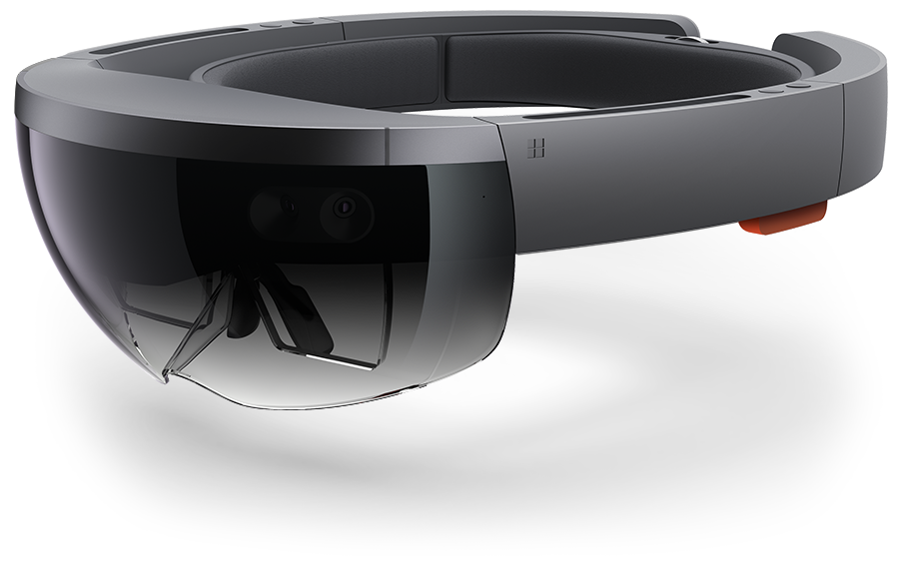
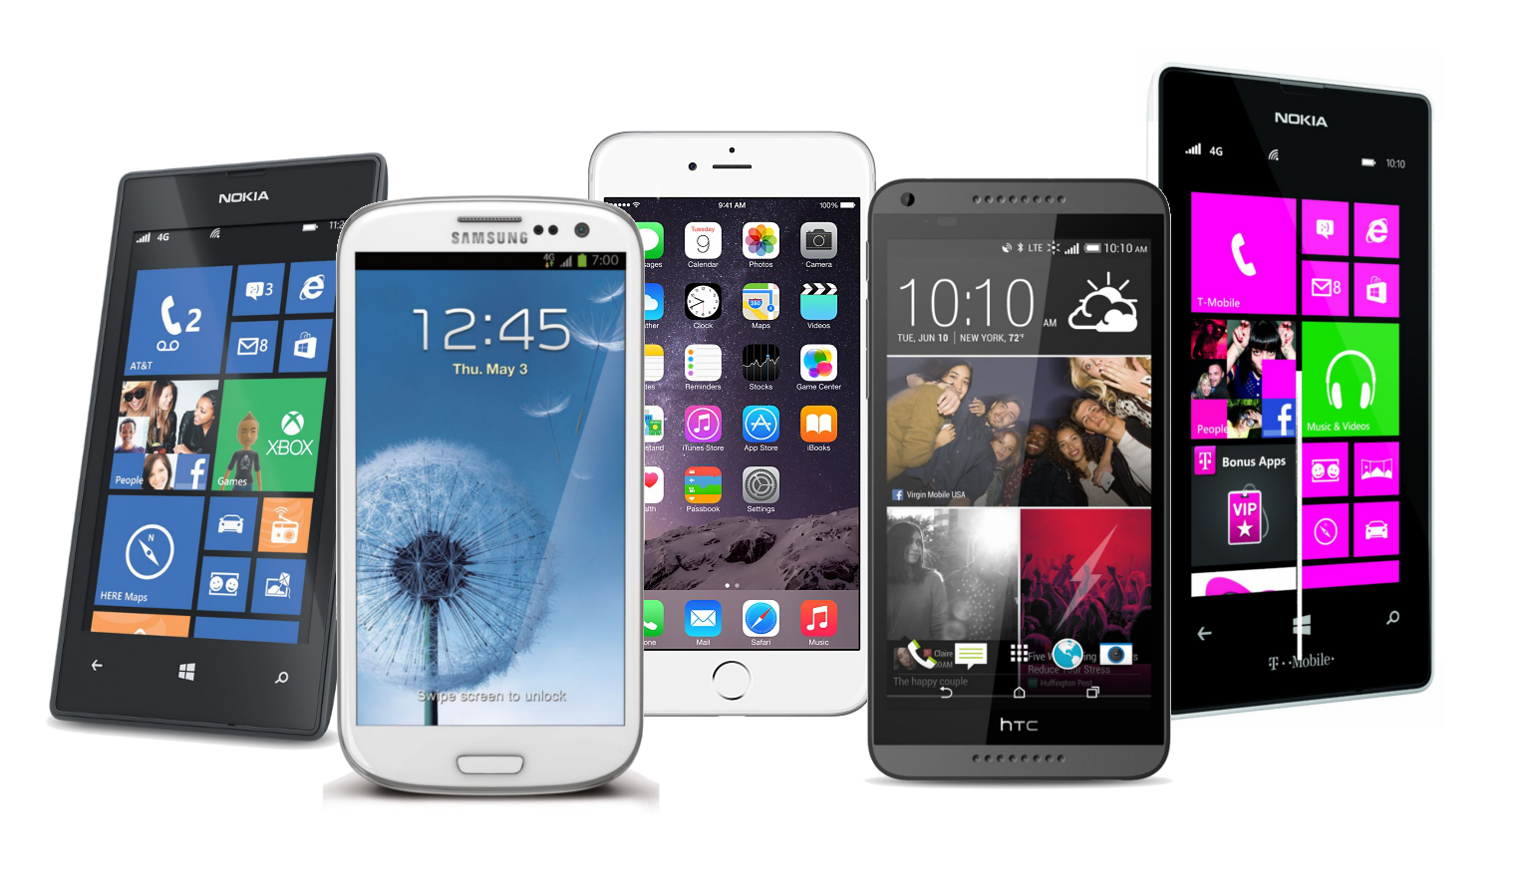


Devices
Hololens by Microsoft
Internet of things (IOT)

Slide 4
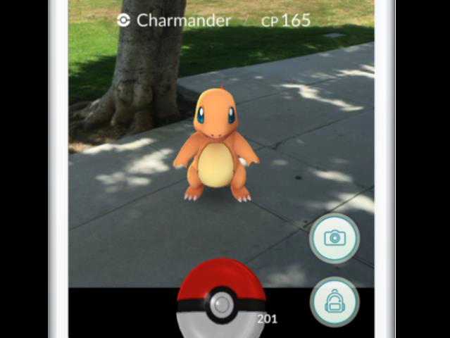
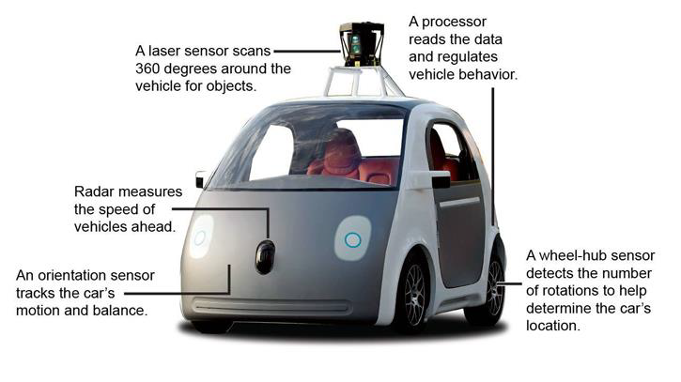
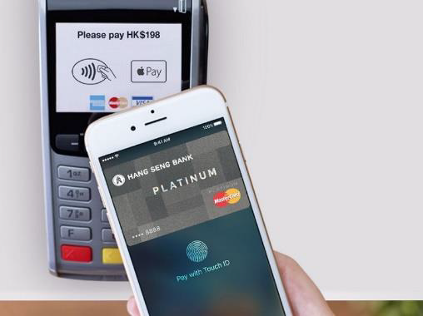

Applications

Slide 5
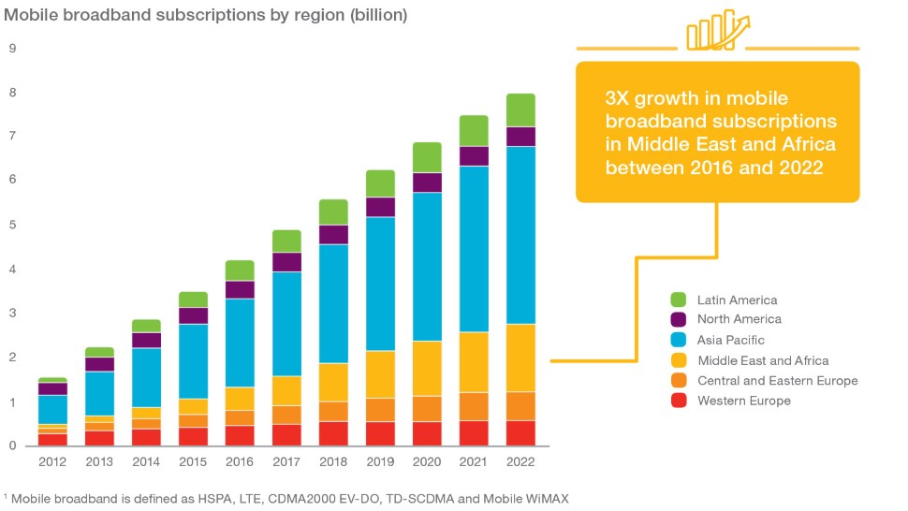
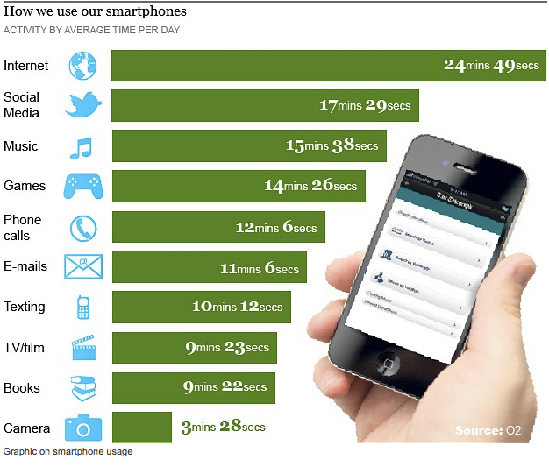
Trends & Usage
A mobile phone subscription refers to the use of public mobile telecommunication systems (also called mobiles or cellphones) using cellular technology.
e.g. number of active sim cards
Over 2.2 million Android apps
Over 2 million Apple apps
Over 300 million downloads per year

Slide 6
Challenges in Technologies
Hardware - Lighter, smaller, lower energy consumption
Software & User interface - heterogeneous devices, different interaction styles
Network - Lower bandwidth, low reliability, higher delays, more jitter, different protocols
Location awareness

Slide 7

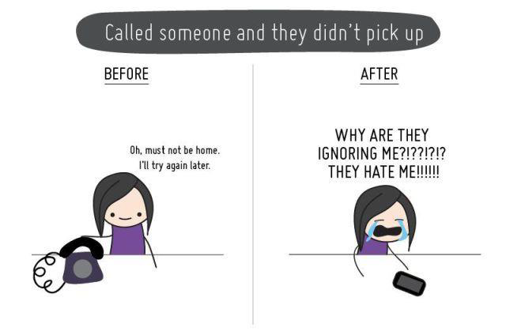
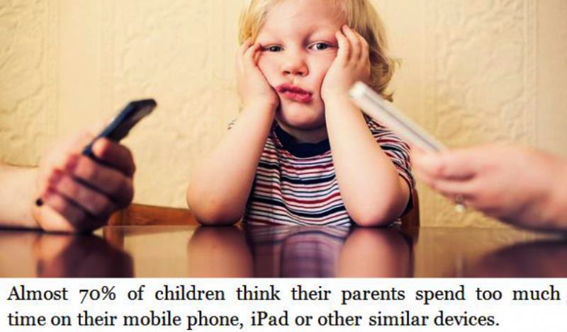
Social Impacts
Privacy
Psychological Impact

Slide 8
Module Contents
Review of Java programming (Week 1~2)
Homework
No lab sessions
Android Development, using Java (Week 2~8)
Lab sessions starts from Week 3.
Mobile Networking & Algorithm (Week 9~14)
No lab sessions
Mock exam paper
*I might adjust the schedule

Slide 9
Learning Outcomes
Have an understanding of the characteristics and limitations of mobile hardware devices including their user-interface modalities
Be able to develop applications that are mobile-device specific and demonstrate current practice in mobile computing contexts
Have an appreciation of the design and development of context-aware solutions for mobile devices
Have an awareness of professional and ethical issues, in particular those relating to security and privacy of user data and user behavior.

Slide 10
Learning Outcomes
In other words, you will:
Know how smartphone system works.
Design and develop a smartphone app.
Address some critical issues during the design.
This will help you in:
Practicing your app design and development skills.
Making your phone more interesting.
Possibly startup your own business.

Slide 11
Assessments
Grading Scheme:
85% - Individual and group android design project
15% - In-class project and assignment

Slide 12
Assessments (Past)
Grading Scheme:
45% - Individual and group android design project
15% - In-class project and assignment
40% - Final exam

Slide 13
Reference Books
Context-Aware
Stefan Poslad (2009). Ubiquitous Computing - Smart Devices, Environments and Interactions.
Thomas et al. (2009). Introduction to Algorithms (3rd edition).
Mobile application development
Official Android tutorials and manuals
Reto Meier (2008). Professional Android Application Development.
Mobile communication
Martin Sauter (2006). Communication Systems for the Mobile Information Society.
Jochen Schiller (2003). Mobile Communications (2nd edition).

Slide 14
Getting Help
Do the research yourself
Search engine
Group discussion
Videos online are also good.
Office hour:
Jianjun Chen (Jianjun.Chen@xjtlu.edu.cn)
Office: SD541
Every Tuesday 16:00 ~ 18:00

Slide 15
Java Lang Review, Part I
Basic data types to compound data types
Operators to functions

Slide 16

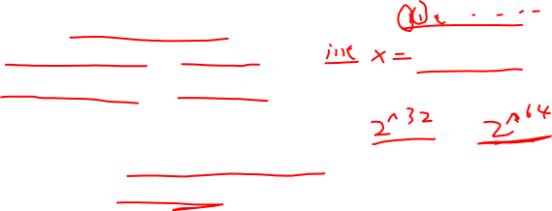
Basic Types
Limited memory space
16GB on personal computer is quite common.
Limited memory unit size (word size)
32 bit registers for 32 bit CPU.
64 bit registers for 64 bit CPU.
Thus, limited quantity of numbers can be represented in one word (32/64 bits)

Slide 17
Basic Types
A basic data type follows a certain way of mapping sequences of 1/0 bits to human-understandable symbols.
For example, a real number 17:
Under two’s-complement representation
Under IEEE 754 floating point representation
Gaps between extreme floating-point numbers.

Slide 18
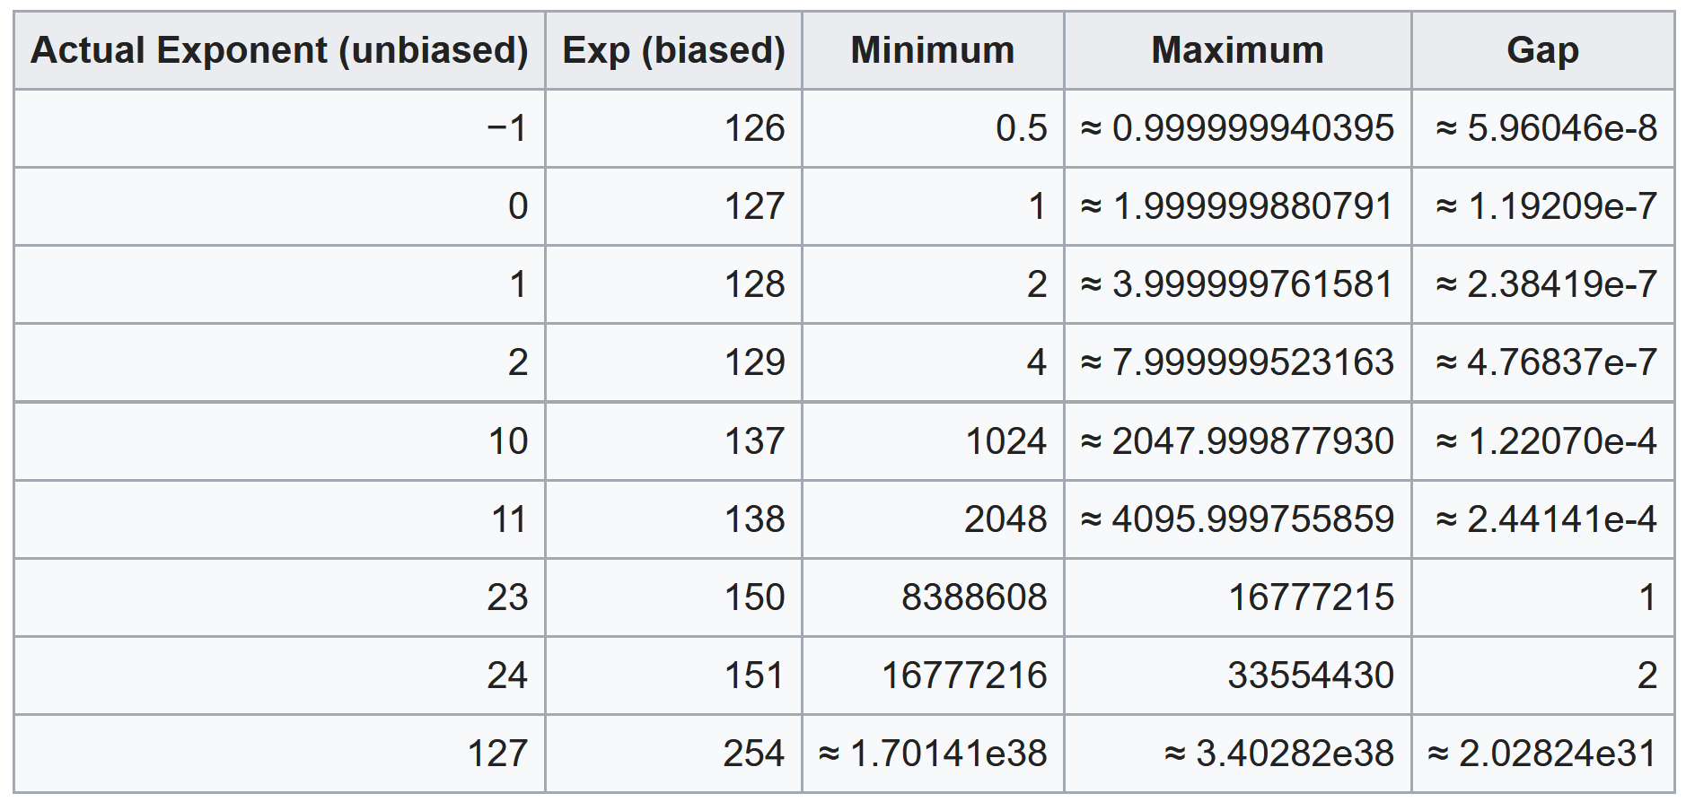
Gaps between Floating Numbers

Slide 19
Basic Types
Another example:
Character ‘a’ in ASCII table maps to binary number: 0110 0001
Same as the binary representation of decimal number 97.
Their binary representations are identical in registers or memory.
However, they are treated differently by CPU instructions.
These instructions are generated by compilers based on both data types and operators in the source code.

Slide 20
Operators
Basic “functions” provided by the programming language.
They behave like functions
“parameters” plus a “return value”.
For example:
Multiplication operator (*): takes two numbers and returns another number
Logical negation (!): takes a Boolean and returns a Boolean.
Assignment operator (=): ?
Takes, as parameters, two expressions and returns the value assigned.

Slide 21
Expressions
“An expression is a sequence of operators and operands that specifies computation of a value, or that designates an object or a function, or that generates side effects, or that performs a combination thereof.”
Computation of a value: 5 + 0.7
A function: System.out.println()
Side effects: y = z = 3

Slide 22
Question
Is the following code an expression?
x = x + 3;
All expressions can be evaluated into a value.
If/else, while, for … statements are not expressions;
Notes:
“x = x + 3;” is a statement

Slide 23
Rules of Expressions
Expression := identifier
x = 5 // x is the identifier
Expression := constant
5, 5.55, ‘a’
Expression := string-literal
“abc”
Expression := (expression)
Expression := Expression + - * / = Expression
Expression := function_name(expression, expression)
Any expression can be interpreted as a tree. Each branch strictly follows the rules like above

Slide 24
An Example: y = 3 * x + 1
=
y
+
*
1
3
x
Value of x
Flow of logic

Slide 25
An Example: y = 3 * x + 1
Expr := Expr = Expr
y = 3 * x + 1
Expr := identifier
y
Expr := Expr + Expr
3 * x + 1
Expr := Expr * Expr
3 * x
1
3
Expr := identifier
x
Value of x
Expression Rule at each step

Slide 26
An Example: y = 3 * x + 1
Expr := Expr = Expr
y = 3 * x + 1
=
Expr := identifier
y
Expr := Expr + Expr
3 * x + 1
y
+
Expr := Expr * Expr
3 * x
1
*
1
3
Expr := identifier
x
3
x
Value of x
Flow of logic
Expression Rule at each step

Slide 27
Expression Properties
Can you list the properties associated with the following underlined expressions?
A[5] = 1
a * b
y = 12
System.out.println()
*Hint 1: what will be changed after execution? What information is used when generating instructions for them?
*Hint 2: You may start from thinking about the properties associated with a simple variable first.
Notes:
e.g.
a[5] -> mem addr, data type
We are storing 1 to that memory address. But before that, we need to optionally convert constant 1 to the target type if Array ‘A’ is of type double[]

Slide 28
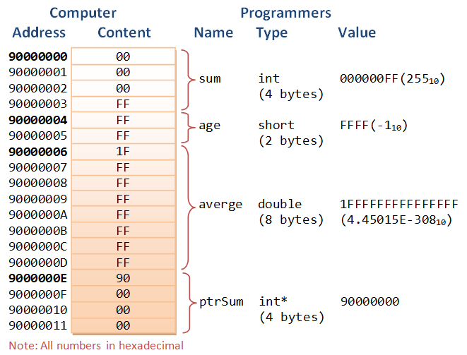
Expression Properties
Three most important properties:
Memory address
Content
Data type

Slide 29
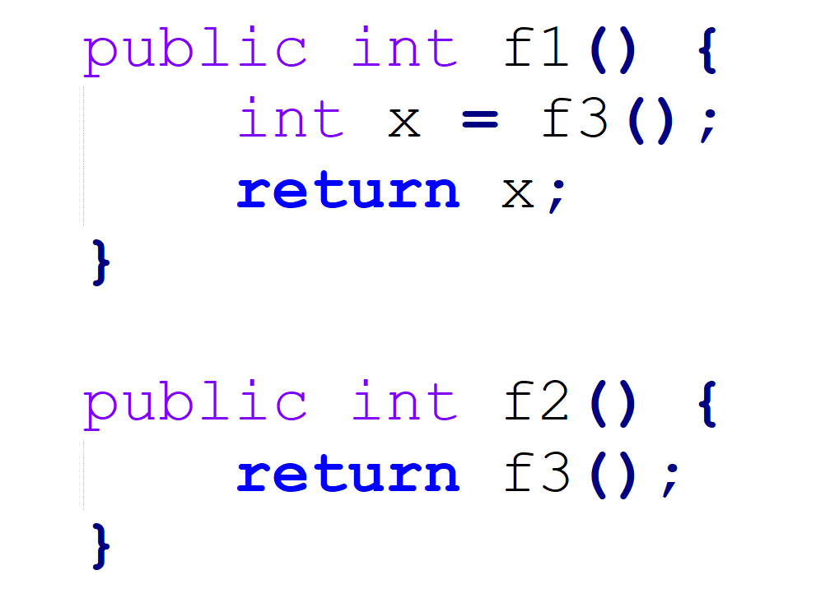
Test 1
Which properties are involved in the following expressions (red part)?
strArray[5] = “new string”
y = strArray[1]
Compare the two functions on the right
do they consume different amount of memory?
How about computational time?

Slide 30
Test 2
Compare the expressions below. Assume x is 10 and y is 12:
System.out.println("result is " + (x + y));
System.out.println("result is " + x + y);
What does the output look like? Why? Explain using the knowledge of operators.

Slide 31
Test 3
When we create objects, what information is associated with their identifiers?
String str = new String();
What kind of content is stored in str?
Identifiers of objects store the references.
Reference: the memory addresses that stores data.
The content of objects are stored in heap.
Keyword “new” allocates objects at heap.

Slide 32
Homework
Can you implement for loops using only functions?
forLoop(???, ???, ???);
You are allowed to add helper classes.
forLoop() function must not contain for, while, do while statements.
Consider a simple case of getting the sum of the numbers in an array

